Slide 1
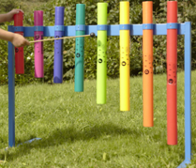
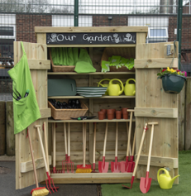
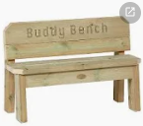
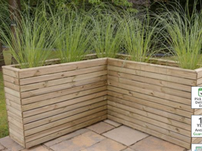
Friends of Ysgol Meifod Summer ’23 newsletter
Exciting news...Jacqui in The friends has been successful in applying for a grant through the "Hafren Dyfrdwy Community Fund". Each year Hafren Dyfrdwy feel it’s really important to be right at the heart of our community, which is why in 2021, they launched a £50,000 Community Fund, to support local projects and give back to our wonderful customers and communities. They encourage applications from non profit organisations and charities, and seek to fund projects that have a genuine community need and stand out as having a real impact on one of these key elements of community wellbeing (People, places and environment).Favourability shown to projects that ideally lie within a ‘sweet spot’ that incorporates all three.
We have been chosen by a panel from over 15,000 projects and awarded c£9,800* to provide seating areas, raised planters, gardening hub, sensory equipment, pergola’s, gardening equipment, outside growing hub and create a beautiful community space around the existing play area. Solar lights and water butts, recycling etc. The area will start from the front entrance gate / trees to the new tarmac perimeter and be a community hub for all! We are so excited and want you to get involved with creating this amazing space! Examples of what was requested:
Raised since last update:
Cake sale 28/04 – Massive thank you Tina Roberts & Eleanor Halliday- £100.54
Name the Corgi – Massive thanks Karen Rushworth - £54
Disco 2 – coronation 05/05 – £142.39
Coronation 07/05 - Village Picnic - £132.75
Coming up:
Cake sale – 16th June
Maintenance day – 17th or 24th June? – Mr Jones would like parental/family support to tidy, clean and maintain back area of school – details to follow.
Sports day - 27th June (cakes/raffle/uniform)
Family day – Sunday 25th June –Lunch – tickets available see Cath
Meifod Village show – 22nd July
*Strict grant criteria – only items requested on application will be allowed.
How you can help…its not always financial support we need!
Easy fundraising - https://www.easyfundraising.org.uk/how-it-works
(shop online as normal and donation is given to school! Doesn’t cost you anything)
Dragon bin –Recycle unwanted clothes and raise funds for your school! https://www.dragonbags.co.uk/
Play area latest…
Powys CC inspection highlighted some installation issues. Installation company are in the progress of rectifying and once completed will be officially opened. This project has been funded by the National Lottery and The Friends. Launch date tbc.
Friends Ysgol Meifod FYM2023@yahoo.com Beth Edwards (Chair) Cath Pritchard (Treasurer) Jacqui Bullen (Secretary)
Next meeting - Tuesday 20th June
Teams 7.30pm – link to follow
All welcome ☺

